Slide 1
EFFECTS of MENTAL and PHYSICAL TRAININGS in MOTOR SKILL in SOCCER
MiÇOOĞULLARI, B.O., ÖDEK, U., AKPINAR, S., BEYAZ, Ö.
NHBVU-2018

Slide 2
INTRODUCTION
Motor imagery with mental practice is a non-invasive technique in which physical tasks, scenarios, or both are imagined and cognitively rehearsed, usually without voluntary physical movements.

Slide 3
INTRODUCTION
It is a dynamic state in which the representation of a specific motor action is internally activated without any motor output (Wu et al., 2010). The present study aimed to explore the possible role of motor imagery in the learning of complex motor skill in soccer (head kick).

Slide 4
INTRODUCTION
The process of learning motor skills is very complex, as it involves interactions between two or more people.
Although motor skills vary considerably in type and complexity, the learning process that people go through by attaining different motor skills is almost same.

Slide 5
INTRODUCTION
The effects of training strategies on the acquisition of motor and cognitive skills have occupied a very privileged place of interest amongst the teachers, researchers, and theorists of motor learning and performance (Adams, 1971, 1992; Famose, 1987, 1991; Hall, Bernoties, & Schmidt, 1995; Murphy & Martin, 2002; Schmidt & Lee, 2005; Shapiro & Schmidt, 1982; Weinberg & Gould, 2003).

Slide 6
METHOD
The sample of the study consisted of 40 university students were assigned (18 female, 22 male) to either mental practice (motor imagery) with physical training, or physical training alone (mean ± s: 20.54 ± 1.8).
Head kick performances were applied and assessed pre and post an eight-week soccer course.

Slide 7
METHOD
A video analysis was implemented by three experts on the head kick pre and post-course.
One-Way ANOVA was used to determine the difference between experiment and control group results in two conditions and Dunnent’s C Test was used for determining the differences across groups through SPSS Package 23.0.

Slide 8
RESULTS
The mental practice group showed greater improvement in performance than the control group. Five repeated measures 2 groups (experiment & control) X 2 times (pre & post course) ANOVAs applied to test the significance of the differences observed in the two conditions.

Slide 9
RESULTS
Results of the ANOVA showed;
A significant effect of training condition on
“Timing” [F(_{1, 38}) = 5.603, p < .05, η² = .078] and
A significant effect of training condition on
“Coordination” [F(_{1, 38}) = 4.247, p < .05, η² = .070]

Slide 10
RESULTS
A significant effect of training condition on “Positioning” [F (_{1, 38}) = 4.803, p < .05, η² = .069],
Whereas the other feature (Landing) did not significantly differ between two conditions.

Slide 11
DISCUSSION
Consistent with the aim of the study, results indicate that combined mental and physical practice can improve performance of a closed sport task.
These findings are partially in line with those obtained by related studies investigating motor imagery in sports (Guillot et al., 2009; Post et al., 2010)

Slide 12
DISCUSSION
In the present study, the lay-up shot technique was examined with respect to several dimensions (“Timing”, “Coordination”, “Positioning”, and “Landing”).
Among these features, “Landing” was the only feature not showing significant difference among judges.

Slide 13
CONCLUSION
It can be concluded that mental practice condition improved timing, coordination and positioning, suggesting the potential effectiveness of this approach in training complex motor skills.

Slide 14
CONCLUSION
Moreover, findings indicate the feasibility and accuracy of using video-based analysis of movement in the assessment of motor performance improvements.

Slide 15
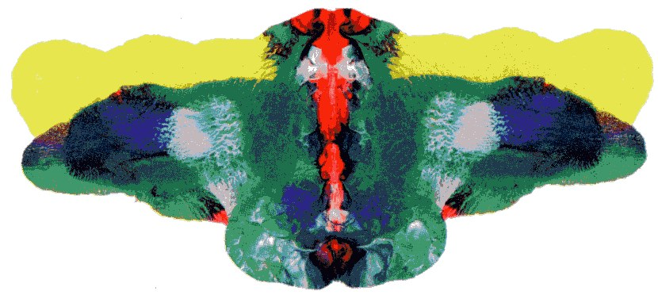
THANKS FOR YOUR ATTENTION

